Slide 1
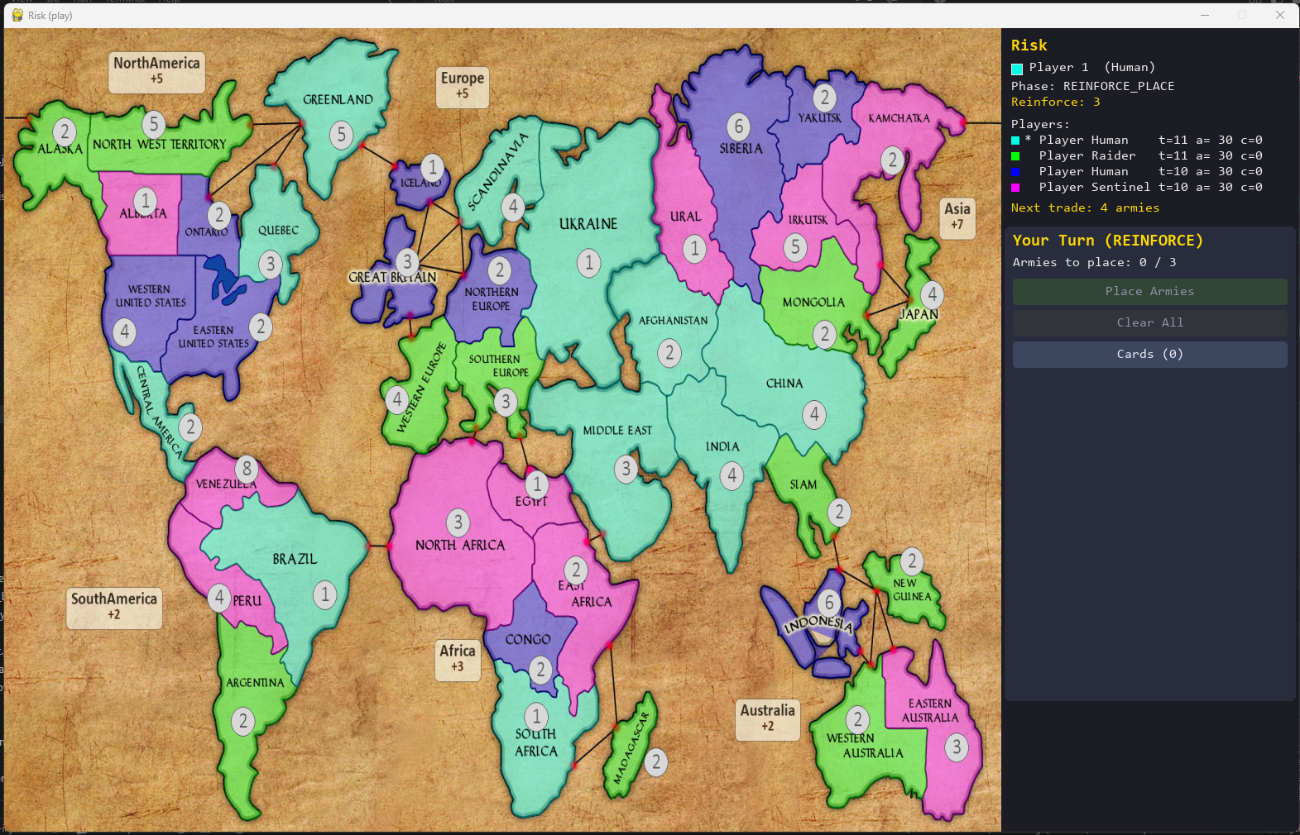

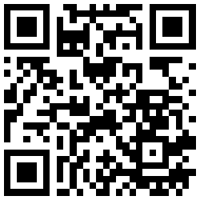

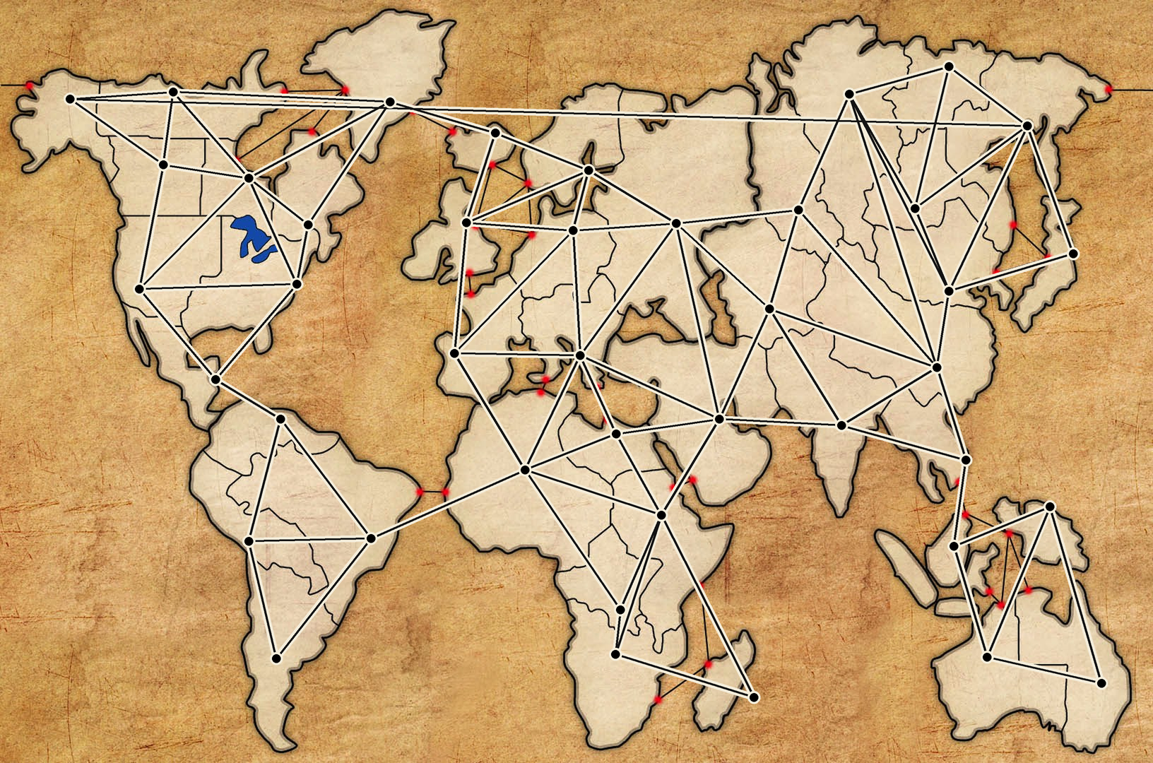
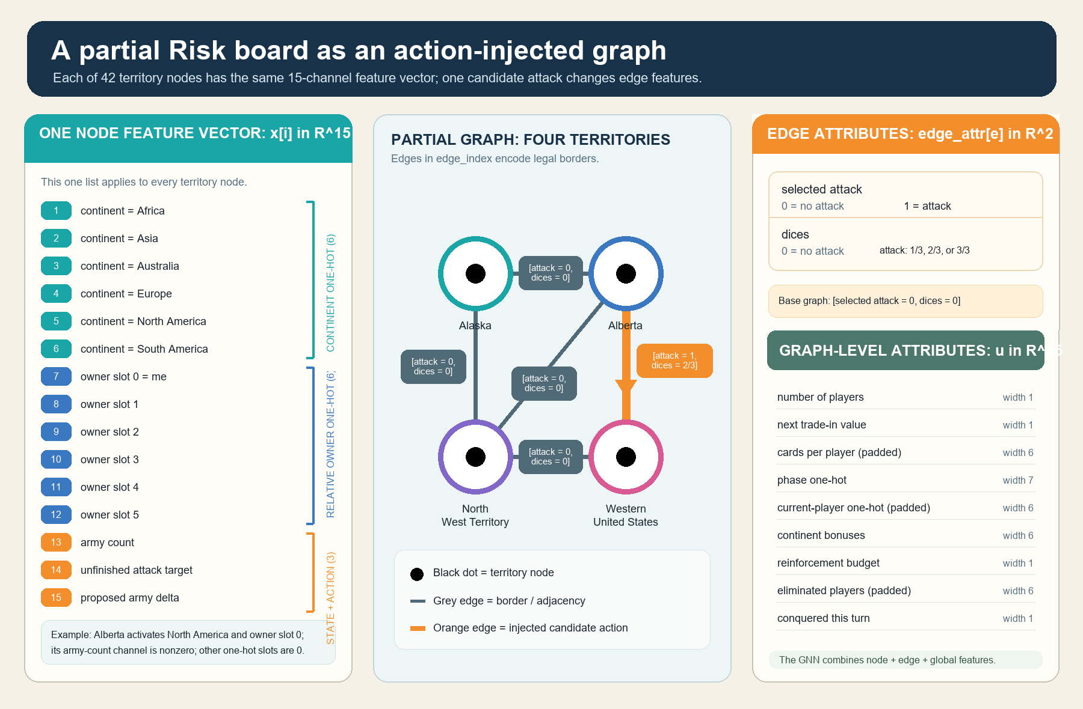
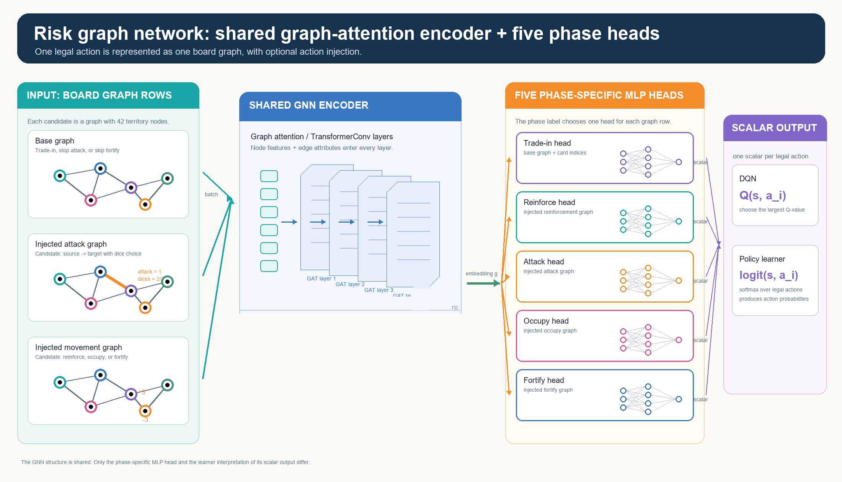
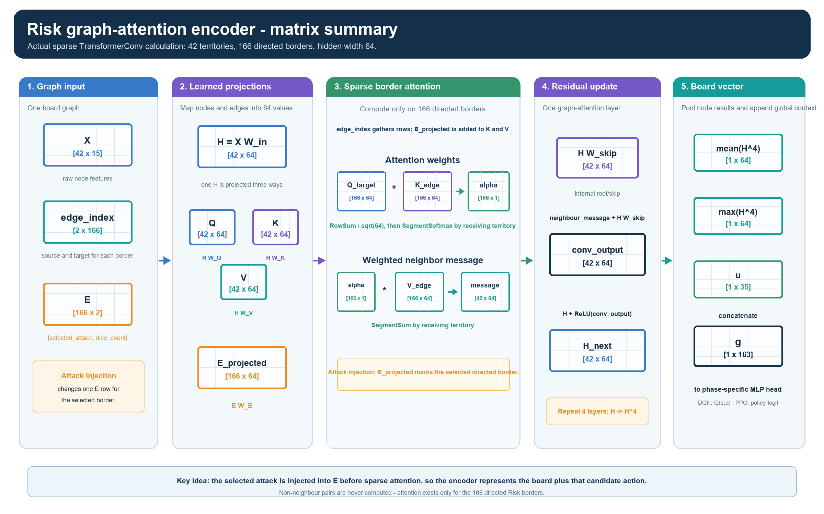
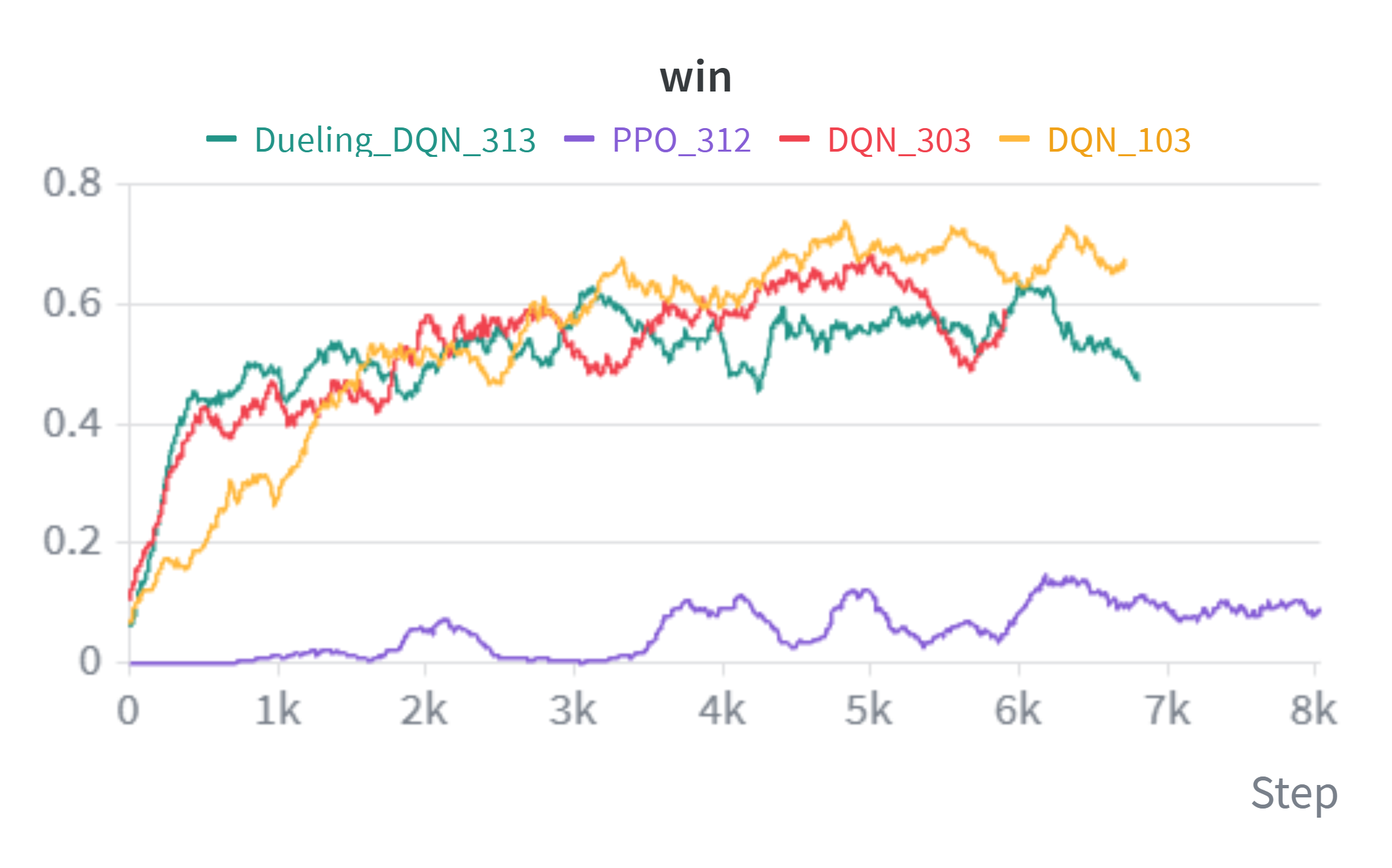
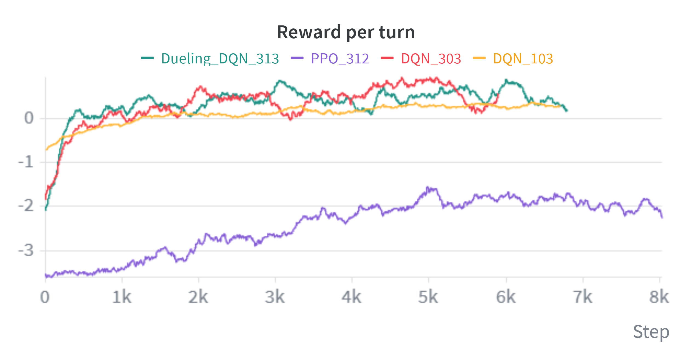
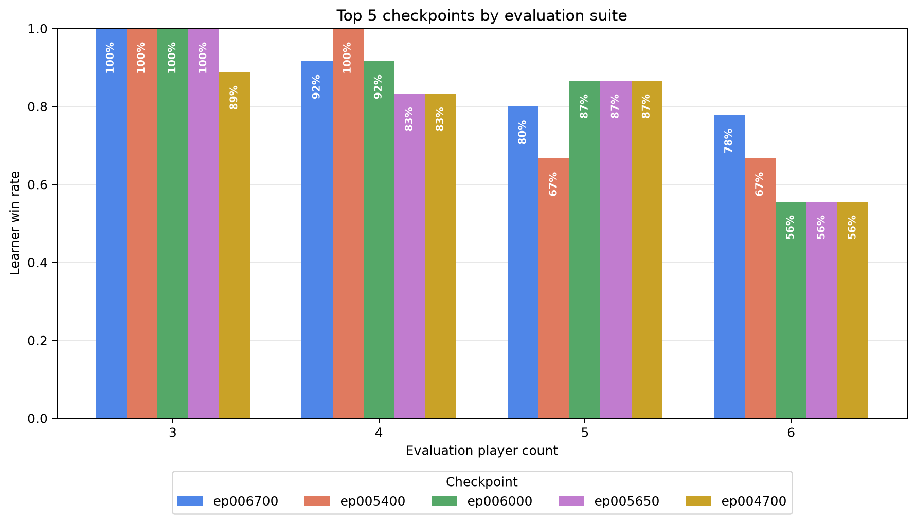
Learning to Play Risk with
Action-Injected Graph Neural Networks
A graph-attention reinforcement-learning approach, compared across DQN, Dueling DQN, and PPO
PROJECT REPOSITORY
Gilad Markman • 2026
Practical Deep Learning for Science • Prof. Eilam Gross
Instead of scoring one enormous fixed move list, the system injects each legal Risk move into the board graph and scores that state–action graph with one shared graph-attention encoder.
1 Board as a graph
2 Inject each legal candidate action
3 Shared GATN encoder + phase heads
Risk's territories and borders are relational: move quality depends on neighbours, armies, and contested continents.
The action becomes part of the graph: an attack changes one border; other phases mark affected territory rows.
Four TransformerConv layers read the injected graph; the current Risk phase selects its small scoring head.
42 territory nodes | 83 borders | 166 directed edges
X [42 x 15] E [166 x 2] u [1 x 35]
How GATN attention uses the injected action
Reward shaping
Phase / trigger | Key DQN_103 calculation | What it teaches
Terminal (game ends) | +100 win; -100 loss (unscaled) | Winning stays the main objective.
Trade-in (optional at 3-4 cards) | +/- 0.30 x hand factor / card-set value +0.60 if a traded card matches an owned territory | Save an optional trade unless it creates value.
Reinforce (place armies) | +1.2 x share placed on a territory bordering an enemy +1.5 x [min(own / weakest adjacent enemy, 2.5) - 1] -0.8 on a safe interior territory | Build an attack-capable border; do not park armies where they cannot fight.
Attack (choose / resolve) | 2 x [min(attacker / defender, 3) - 1.5] +0.6 x (defender losses - attacker losses) +1.2 conquest; +4 continent; + 1.5/card elimination | Use strong odds, maximum dice, and profitable battles.
Occupy + fortify (move armies) | + moved / movable into a captured territory or toward an enemy border Penalty for moving away or leaving two borders badly balanced | Put force where an opponent can attack, then keep it there.
Board progress (after opponents) | 20 x territory-share change; 0.1 x army-share change 2.5 x continent-bonus change; extra continent-loss penalty | Reward gains that survive a full opponent round.
GATN attends only across neighboring territories. Q represents the receiving territory; K determines how relevant each neighbor is; V is the information that neighbor sends. The injected action changes K and V on the affected border, changing its attention weight and message.
Reward =
terminal (+100 / -100)
+
0.1 x local action terms +
0.1 x board progress after opponents.
Four graph-attention layers aggregate these weighted neighbor messages—never all territory pairs.
Local shaping applies only to learner decisions; board progress is separately scaled (not clipped) after every opponent has played.
E [166 x 2] -> E_projected -> K_edge / V_edge -> segment softmax
Results: Reward per agent turn during training
Results: Win Rate evaluated during training
Results: held-out evaluation 3-6 players – DQN 103
Win Rate
Learner comparison
DQN evaluation
DQN | Dueling DQN | PPO
DQN | Dueling DQN | PPO
Top 5 checkpoints · 54 games each
DQN and Dueling DQN improve quickly and reach similar win rates.
PPO improves only slightly and stays far behind, showing poor fit for this game.
DQN and Dueling DQN move from negative rewards to stable positive rewards per turn.
PPO also improves but remains strongly negative throughout training.
54 games / checkpoint
3 seeds · every learner seat
ε = 0 · 2,000-step cap
Latest ep006700
46 / 54 wins = 85.2%
0 timeouts
Notes:
[Sources]
Poster narrative and local visual assets adapted from Docs/Poster.md.
Results:
- DQN card and temporary learner-comparison graphic: Assets/DQN Win.png.
- DQN_103 cross-player-count evaluation: Checkpoints/DQN_103/evaluations/top5_checkpoint_win_rates_all_player_counts.png; checkpoint_eval_ep006200_to_006700.json. Evaluation protocol: 54 games per checkpoint (3 seeds x learner seat x 3-6 total players), epsilon 0, 2,000-step cap.
Reward shaping behind DQN_103:
- Historical checkpoint configuration: wandb/run-20260801_170850-sad3393d/logs/debug.log (REWARD_SHAPING_SCALE=0.1; terminal +/-100).
- Historical implementation: commit 1411c0d (reward.py and train_constants.py). Dense learner-action terms were summed, clipped to [-10,+10], then multiplied by 0.1; terminal reward was unscaled. End-of-turn board progress was separately scaled by 0.1 and measured after opponents acted.
- The poster table summarizes terminal, trade, reinforce, attack, occupy/fortify, and board-progress terms in plain language. Docs/Reward.md contains the full current reward reference; it does not retroactively describe DQN_103's historical values.
Methods and architecture:
- Docs/NetworkArchitectures.md, Docs/DuelingDQN.md, Docs/PPO.md, Docs/Reward.md.
Branding and QR assets are local project assets; Weizmann logo was user-provided.

